Slide 1
Confidence intervals and Bootstrap
Miodrag Bolic

Slide 2
Outline
Some mathematical methods for uncertainty evaluation
Confidence intervals
Resampling:
Bootstrap
Monte Carlo

Slide 3
Confidence Intervals
The value of the statistic in the data sample (eg., mean, median, etc.)
point estimate ± (measure of how confident we want to be) × (standard error)
From a Z table or a T table, depending on the sampling distribution of the statistic.
Standard error of the statistic.

Slide 4
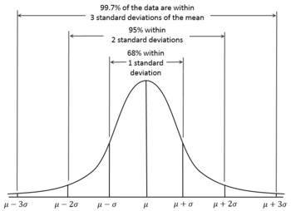

Confidence interval for the mean of Normal distribution with σ known
Suppose that X=(x₁,…,x_{n}) are samples from Normal distribution $X_{i}$ ~ N(µ, ${σ }^{2}$).
Empirical mean $\overline{x}=1/n\sum_{i=1}^{n}{x_{i}}$ and
To determine information about the unknown mean, we consider the sample mean $\overline{x}$. 95% of the area of a normal distribution lies within two standard deviations of the mean

Slide 5

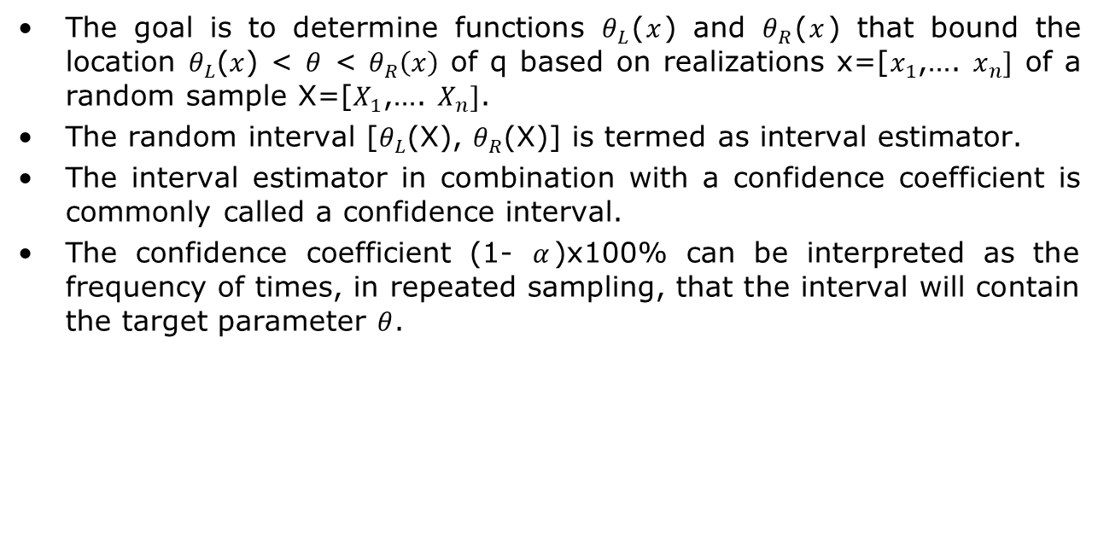
Confidence interval
The goal is to determine functions $θ_{L}$($x$) and $θ_{R}$($x$) that bound the location $θ_{L}$($x$) < $θ$ < $θ_{R}\left(x\right)$ of q based on realizations x=[$x_{1}$,…. $x_{n}]$ of a random sample X=[$X_{1}$,…. $X_{n}]$.
The random interval [$θ_{L}$(X), $θ_{R}$(X)] is termed as interval estimator.
The interval estimator in combination with a confidence coefficient is commonly called a confidence interval.
The confidence coefficient (1- $α$)x100% can be interpreted as the frequency of times, in repeated sampling, that the interval will contain the target parameter $θ$.
$P{[θ}_{L}\text{(}\text{X}\text{)}≤θ≤ θ_{R}\text{(}\text{X}\text{)]}=1−$ $α$
Notes:
Ralph C. Smith, “Uncertainty Quantization, Theory, Problems and Applications,” SIAM, 2014.

Slide 6
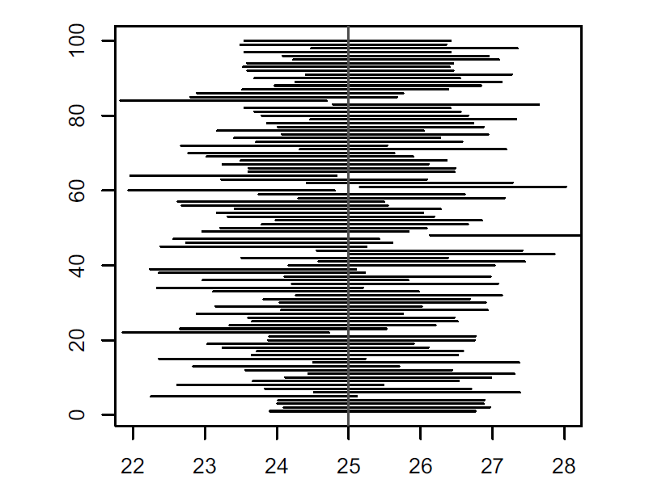
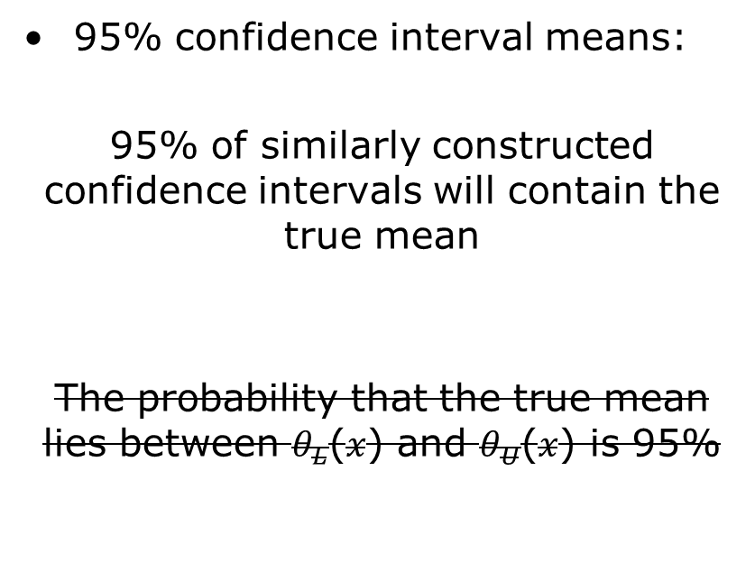
Confidence intervals interpretation
95% confidence interval means:
95% of similarly constructed confidence intervals will contain the true mean
The probability that the true mean lies between $θ_{L}$($x$) and $θ_{U}$($x$) is 95%

Slide 7
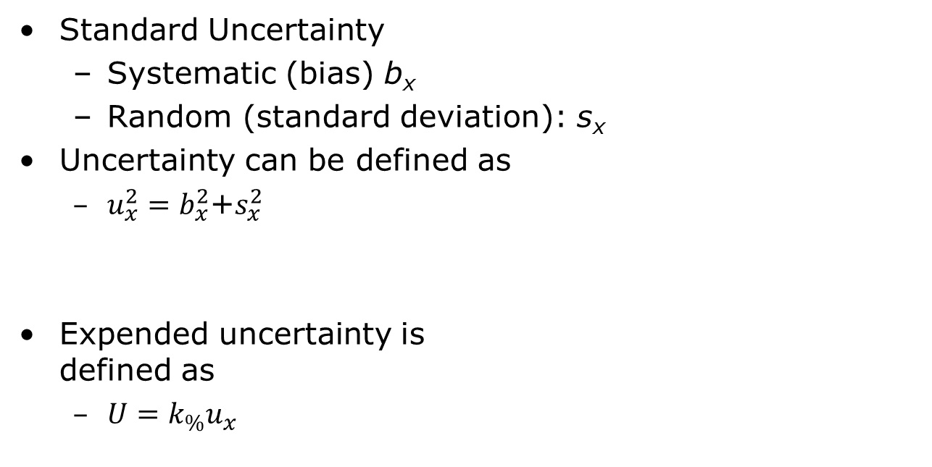
Expended Uncertainty
Standard Uncertainty
Systematic (bias) b_{x}
Random (standard deviation): s_{x}
Uncertainty can be defined as
$u_{x}^{2}=b_{x}^{2}$+$s_{x}^{2}$
Expended uncertainty is defined as
$U=k_{\%}u_{x}$

Slide 8
Definitions
Standard uncertainty
uncertainty of the result of a single type of measurement includes Type A and/or Type B uncertainties
Expanded uncertainty
the standard uncertainty multiplied by a coverage factor
Standard error SE
Standard deviation of the sample statistics

Slide 9
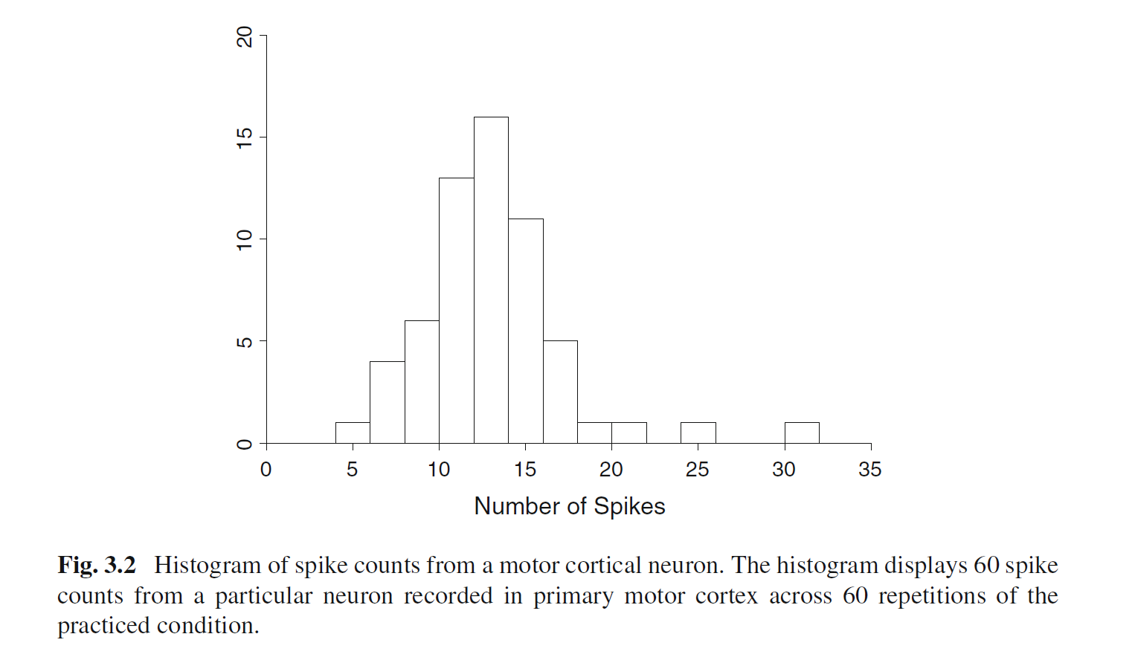
Example – Spike counts from a motor cortical neuron
Button pressing task
The number of spikes from a single neuron is measured in the period of 600 ms
Mean: 13.6 spike per 600ms or 22.7 spikes per second
Confidence intervals?
Notes:
Figure 3.2 displays a histogram of 60 spike
counts from a motor cortical neuron during a reaching task. The mean among these 60
counts is 13.6 spikes. (The time interval was 600 ms, so this neuron’smean firing rate
was 22 spikes per second.) Imagine drawing one spike count at random from among
the 60, and doing this repeatedly. The histogram gives a sense of the variability we
would see in these repeated random draws.

Slide 10
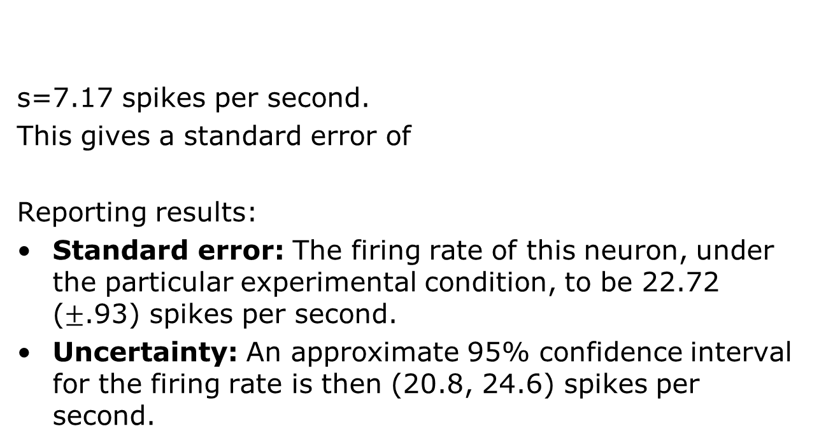
Example – Spike counts from a motor cortical neuron, cont.
s=7.17 spikes per second.
This gives a standard error of
Reporting results:
Standard error: The firing rate of this neuron, under the particular experimental condition, to be 22.72 ($±$.93) spikes per second.
Uncertainty: An approximate 95% confidence interval for the firing rate is then (20.8, 24.6) spikes per second.

Slide 11
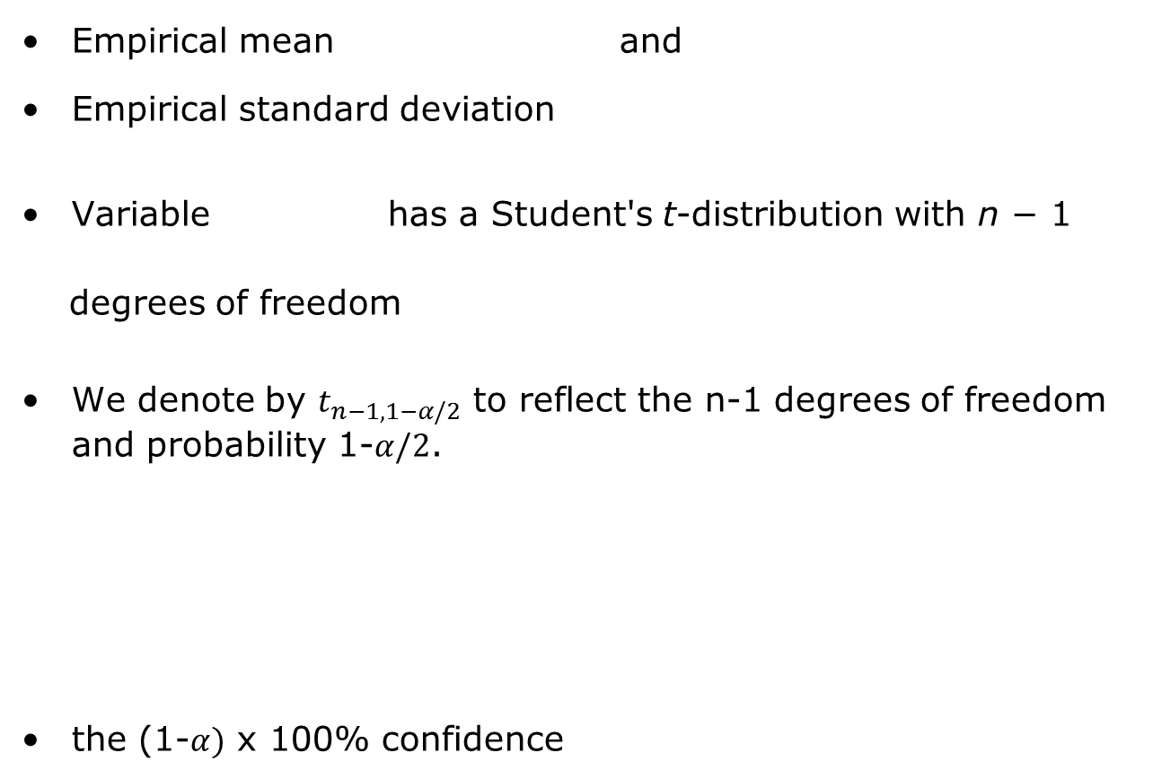
Confidence interval for the mean of Normal distribution with σ unknown
Empirical mean and
Empirical standard deviation
Variable has a Student's t-distribution with n − 1
degrees of freedom
We denote by $t_{n−1,1−α/2}$ to reflect the n-1 degrees of freedom and probability 1-$α/2$.
the (1-$α)$ x 100% confidence
Notes:
If X is sampled from the Normal distribution than
has a standard normal distribution (i.e. normal with expected value 0 and variance 1), and the random variable
{\displaystyle {\frac {{\bar {X}}-\mu }{S/{\sqrt {n}}}}}(where σ has been substituted for S) has a Student's t-distribution with n − 1 degrees of freedom.

Slide 12
Confidence interval for the mean of Normal distribution with σ unknown, cont.
A 95% confidence interval for μ:

Slide 13
Other statistical intervals
Prediction intervals
An intervals that would contain a future randomly selected observation from the distribution, with a specific degree of confidence.
Example: predict sample mean of m future samples
Statistical tolerance limits create an interval that bounds a specified percentage of the population at a given level of confidence.
(such as 99% of the population with 95% confidence)
These intervals are often used to demonstrate compliance with a set of requirements or specification limits.
Notes:
Confidence intervals – analyse the already collected data
Prediction intervals is estimating future estimate (for example, based on consumption of gas from a sample of 5 cars, obtain an interval that contains, with a degree of confidence, the gas consumption of a new car that will operate under specified driving conditions.)
Prediction intervals are useful to predict the performance of one or several of future units. If we would like to estimate performance of large number of units based on a small sample, then instead of computing the confidence interval that contains all of a specified number of units, it is sufficient to construct an interval that contains a large proportion of such units.

Slide 14
Bayesian inference method
Model for data
Likelihood
Data
Bayes theorem
Posterior distribution
Inference
Prior information
By knowing posterior distribution all kinds of estimates can be computed:
Notes:
From “Statistical intervals: Guide for practitioners”

Slide 15
Credible intervals
Interpretation: the probability that the true mean is contained within the given interval is 95%.
Posterior Distribution
95% probability the parameter is here
2.5%
2.5%

Slide 16
Bootstrap
Bootstrap (a resampling procedure) is a Monte Carlo method of simulating `datasets' from an observed/given data, without any assumption on the underlying population.
Resampling the original data preserves (adaptively) whatever distributions are truly present.
Bootstrap helps evaluate statistical properties using data rather than an assumed Gaussian or other distributions.
Notes:
From presentation: Model Fitting, Bootstrap, & Model Selection by G. Jogesh Babu

Slide 17
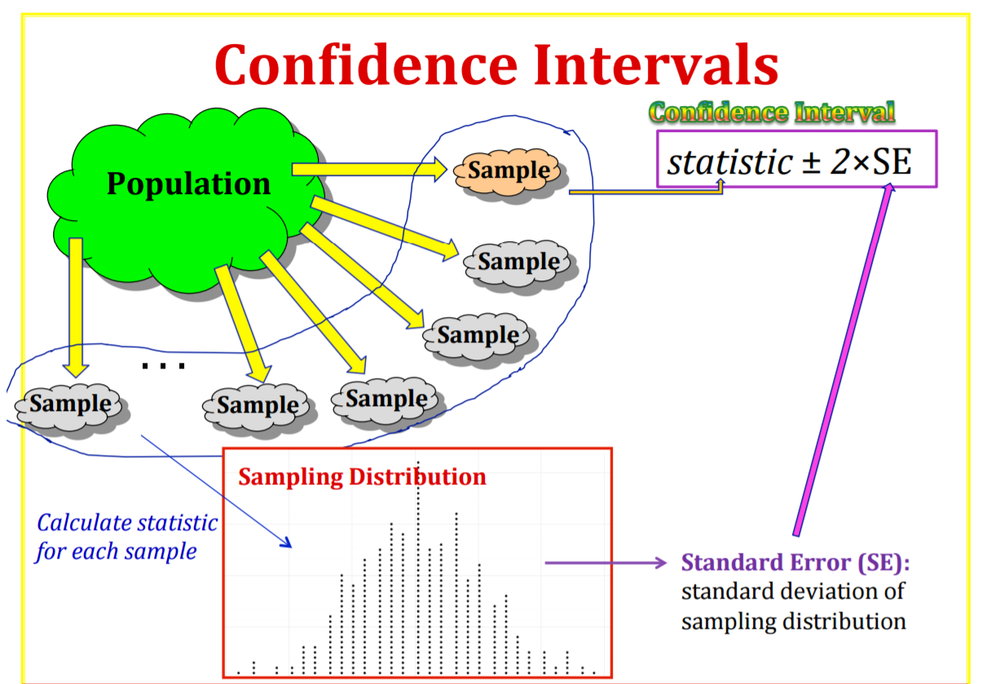

Slide 18
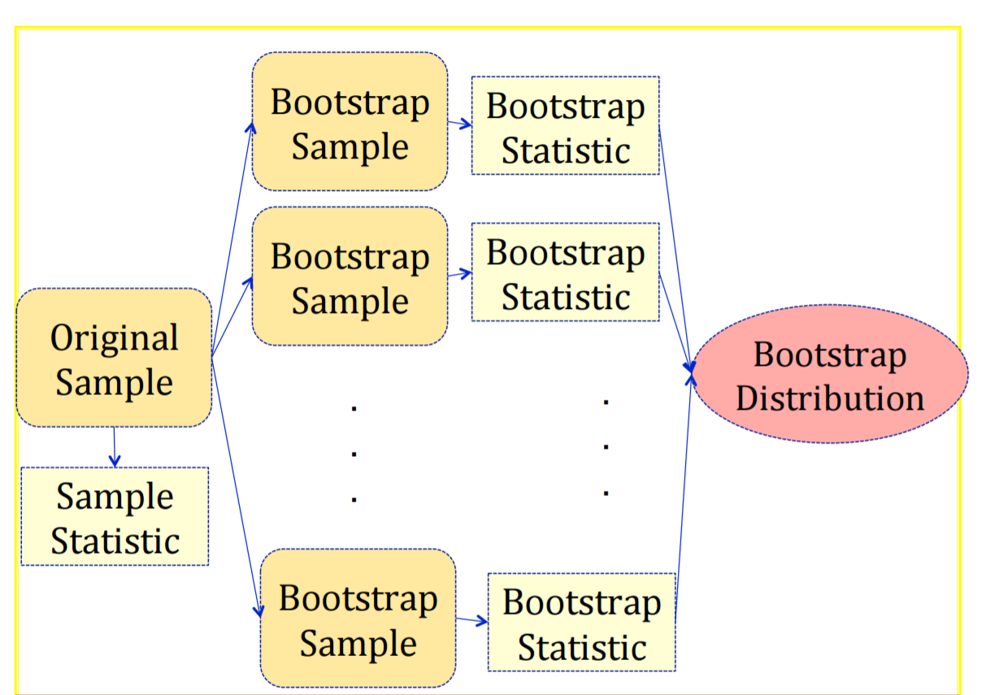
Notes:
A bootstrap sample is a random sample taken with replacement from the original sample, of the same size as the original sample A bootstrap statistic is the statistic computed on a bootstrap sample A bootstrap distribution is the distribution of many bootstrap statistics

Slide 19
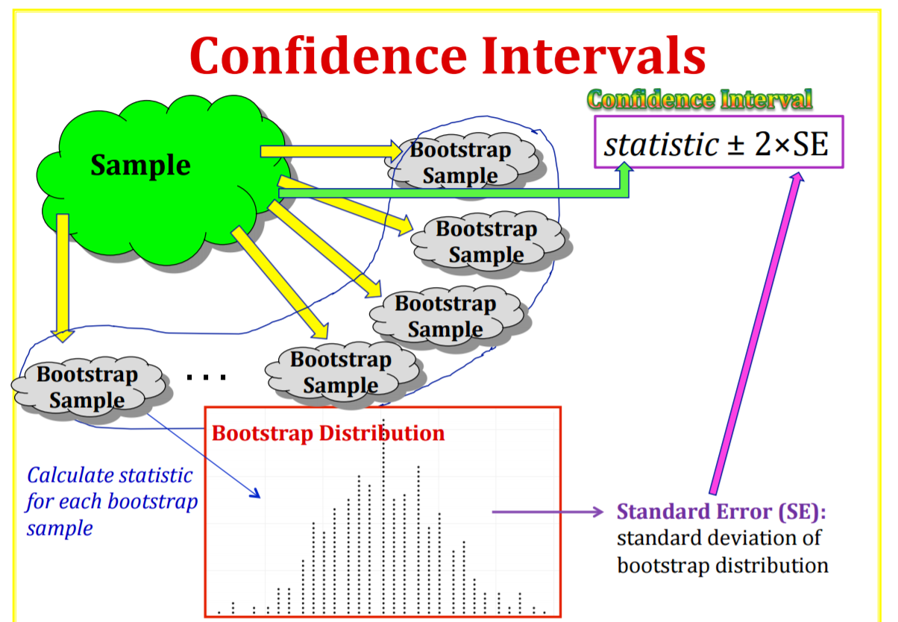

Slide 20

Bootstrap procedure
$X=\left(X_{1},…,X_{n}\right)$ - a sample from a distribution F
$X^{∗}=\left(X_{1}^{∗},…,X_{n}^{∗}\right)$ - a simple random sample from the data
$\hat{θ}$ is an estimator of $θ$
$θ^{∗}$ is based on $X_{i}^{∗}$
Examples:
$$\hat{θ}={\overline{X}}_{n}, θ^{∗}={\overline{X}}_{n}^{∗}$$
$$\hat{θ}=\frac{1}{n}\sum_{i=1}^{n}{{\left(X_{i}−{\overline{X}}_{n}\right)}^{2}, } θ^{∗}=\frac{1}{n}\sum_{i=1}^{n}{{\left(X_{i}^{∗}−{\overline{X}}_{n}^{∗}\right)}^{2}}$$
$\hat{θ}−θ$ behaves like $θ^{∗}−\hat{θ}$
Notes:
From presentation: Model Fitting, Bootstrap, & Model Selection by G. Jogesh Babu

Slide 21
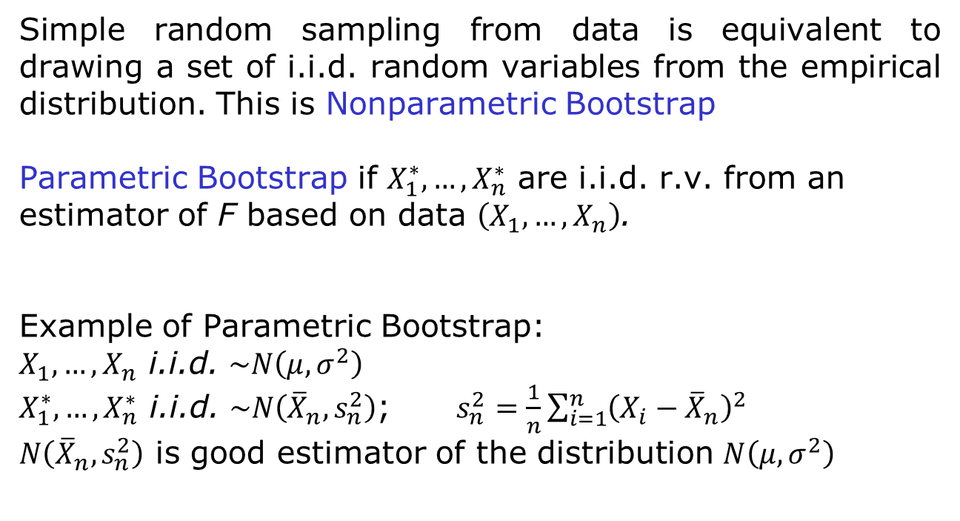
Non-parametric and parametric bootstrap
Simple random sampling from data is equivalent to drawing a set of i.i.d. random variables from the empirical distribution. This is Nonparametric Bootstrap
Parametric Bootstrap if $X_{1}^{∗},…,X_{n}^{∗}$ are i.i.d. r.v. from an estimator of F based on data $\left(X_{1},…,X_{n}\right)$.
Example of Parametric Bootstrap:
$X_{1},…,X_{n}$ i.i.d. $\sim N\left(μ,σ^{2}\right)$
$X_{1}^{∗},…,X_{n}^{∗}$ i.i.d. $\sim N\left({\overline{X}}_{n},s_{n}^{2}\right)$; $s_{n}^{2}=\frac{1}{n}\sum_{i=1}^{n}{{\left(X_{i}−{\overline{X}}_{n}\right)}^{2}}$
$N\left({\overline{X}}_{n},s_{n}^{2}\right)$ is good estimator of the distribution $N\left(μ,σ^{2}\right)$
Notes:
From presentation: Model Fitting, Bootstrap, & Model Selection by G. Jogesh Babu

Slide 22
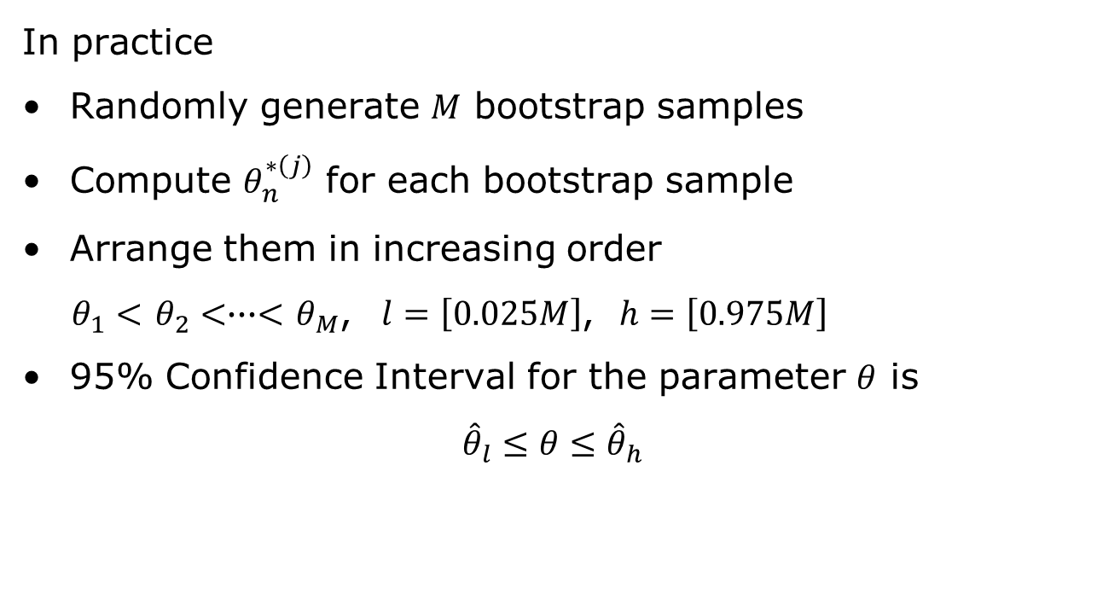
Bootstrap percentile confidence interval
In practice
Randomly generate $M$ bootstrap samples
Compute $θ_{n}^{∗\left(j\right)}$ for each bootstrap sample
Arrange them in increasing order
$θ_{1}<$ $θ_{2}<∙∙∙<$ $θ_{M}$, $l=\left[0.025M\right]$, $h=\left[0.975M\right]$
95% Confidence Interval for the parameter $θ$ is
$${\hat{θ}}_{l}≤θ≤{\hat{θ}}_{h}$$
Notes:
From presentation: Model Fitting, Bootstrap, & Model Selection by G. Jogesh Babu

Slide 23
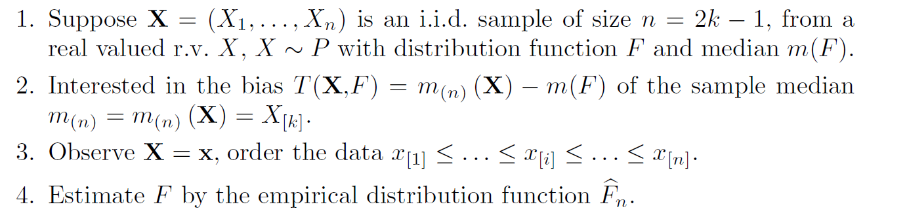
Sample median bias

Slide 24
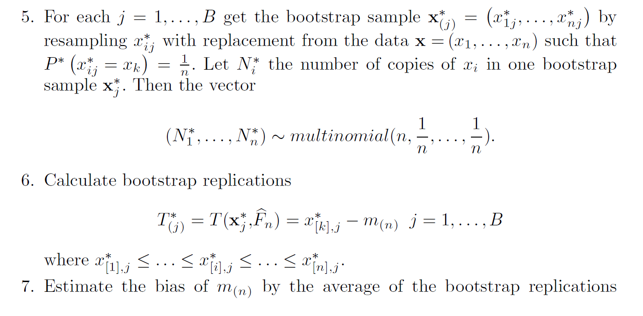
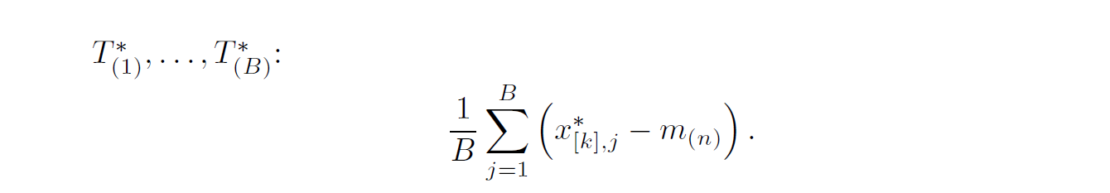

Slide 25
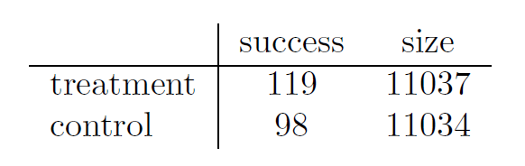
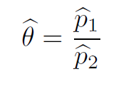
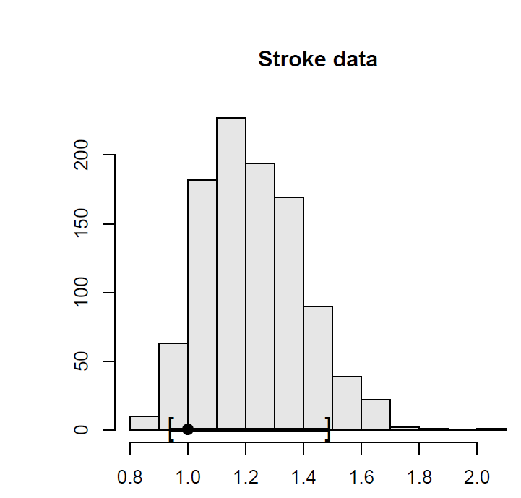
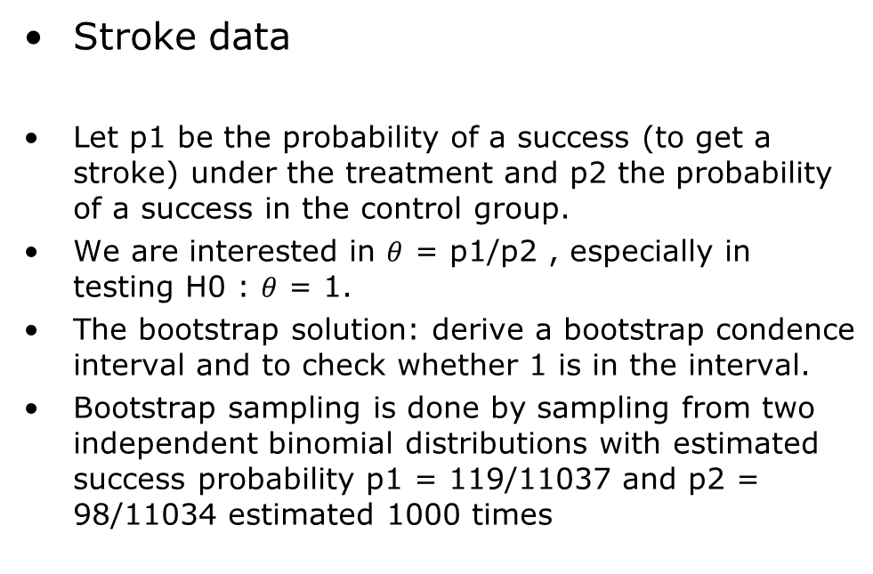
Hypothesis testing with bootstrap
Stroke data
Let p1 be the probability of a success (to get a stroke) under the treatment and p2 the probability of a success in the control group.
We are interested in $θ$ = p1/p2 , especially in testing H0 : $θ$ = 1.
The bootstrap solution: derive a bootstrap condence interval and to check whether 1 is in the interval.
Bootstrap sampling is done by sampling from two independent binomial distributions with estimated success probability p1 = 119/11037 and p2 = 98/11034 estimated 1000 times

Slide 26
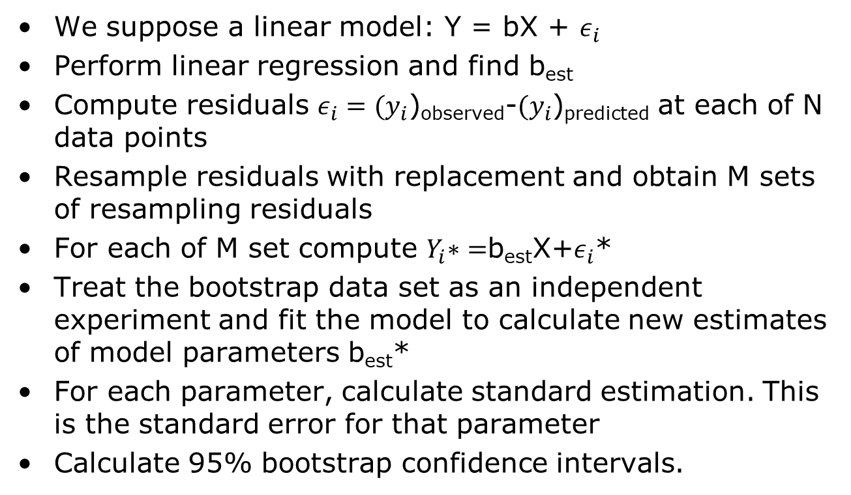
Estimating bootstrap confidence intervals in regression
We suppose a linear model: Y = bX + $ε_{i}$
Perform linear regression and find b_{est}
Compute residuals $ε_{i}={(y}_{i}$)_{observed}-${(y}_{i}$)_{predicted} at each of N data points
Resample residuals with replacement and obtain M sets of resampling residuals
For each of M set compute $Y_{i}\text{∗}=$b_{est}X+$ε_{i}$*
Treat the bootstrap data set as an independent experiment and fit the model to calculate new estimates of model parameters b_{est}*
For each parameter, calculate standard estimation. This is the standard error for that parameter
Calculate 95% bootstrap confidence intervals.

Slide 27
Bootstrap for time series
$\left(X_{1},…,X_{n}\right)$ are identically distributed but not independent or they belong to time series
Standard bootstrap does not work
Approaches
Moving-block bootstrap
Stationary autoregressive bootstrap
Notes:
From presentation: Model Fitting, Bootstrap, & Model Selection by G. Jogesh Babu

Slide 28
Moving-block bootstrap
Break time series into little blocks.
Resample the blocks, not individual points – kind of “random
shuffling”, with replacement.
Within blocks, structure is preserved.
Works if structure between blocks is (quasi) i.i.d.
Determine the parameter of interest for each block
Form the empirical distribution of the parameters and find the percentile confidence intervals
0
30
Notes:
From presentation: Model Fitting, Bootstrap, & Model Selection by G. Jogesh Babu

Slide 29
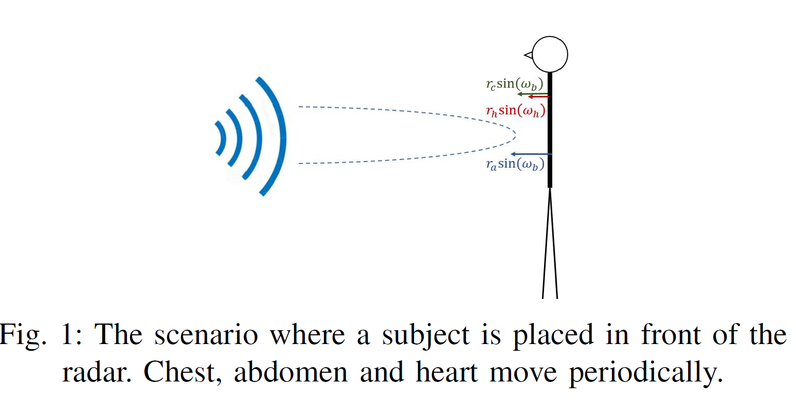
Confidence intervals for estimated breathing rate from the radar signal

Slide 30
Confidence interval for estimating breathing rate from the radar signal, cont.
We are using bootstrapping method in order to find a confidence interval for each estimation method.
Every 3 seconds the last 30 seconds are considered.
100 random 15 seconds are chosen and one estimation is given for each segment.
Mean and variance of estimations is calculated
Mean of estimation error is calculated
0
30
3
33

Slide 31
Confidence interval for estimating breathing rate from the radar signal, cont.
Block bootstrap
Breathing rate Estimation
Confidence intervals and bias estimation
$$f_{i}$$
$$i = 1 … 100$$
$$e_{i}$$
$$i = 1 … 100$$
$f_{est }=μ_{est }= mean(f_{i})$ ${ σ}_{est}=std(f_{i})$
95% confidence interval $=[μ_{est }−1.96σ_{est}$ ,${ μ}_{est }+1.96σ_{est}$]
Error = $mean(e_{i})$

Slide 32
Experimental data: Stationary Subject sitting in front of the radar

Slide 33
Bootstrapping Stationary AR process
The stationary AR(P) model can be parametrically bootstraped
Assume
$$y_{t}=φ_{1}y_{t−1}+φ_{2}y_{t−2}+…+φ_{P}y_{t−P}+ε_{t}$$
Usual assumptions, including stationarity
Can use a parametric bootstrap by estimating the residuals
$${\hat{ε}}_{t}=y_{t}−{\hat{φ}}_{1}y_{t−1}+…+{\hat{φ}}_{P}y_{t−P}$$
Algorithm (Stationary Autoregressive Bootstrap)
Estimate the AR(P) and the residuals for $t=P+1,…,T$
Recenter the residuals so that they have mean 0
$${\tilde{ε}}_{t}={\hat{ε}}_{t}−\overline{\hat{ε}}$$
Draw $u$ uniform from $1,…,T−P+1$ and set $y_{1}^{∗}=y_{u}$,
$$y_{2}^{∗}=y_{u+1},…,y_{P}^{∗}=y_{u+P+1}$$
Recursively simulate $y_{P+1}^{∗}…y_{T}^{∗}$ using $\tilde{ε}$ drawn using an i.i.d. bootstrap
K. Sheppard, “The Bootstrap,” Course: The Econometrics of Predictability, University of Oxford, April 30, 2014
Notes:
https://www.kevinsheppard.com/images/6/64/AFE_Week_1_handout.pdf

Slide 34
Monte Carlo methods
Use
Solving integrals
Propagating uncertainties
Sequential Monte Carlo methods for parameter estimation
Solution
Problem
Estimate
posterior
Integrals are
not tractable
Monte Carlo
Sampling
Difficult to
draw samples
Importance
Sampling

Slide 35
Evaluating integrals using Monte Carlo methods
Example: Estimate the variance of a zero mean Gaussian process
Monte Carlo approach:
Simulate M random variables from a Gaussian distribution
Compute the average

Slide 36
Importance sampling
Classical Monte Carlo integration – Difficult to draw samples from the desired distribution
Importance sampling solution:
Draw samples from another (proposal) distribution
Weight them according to how they fit the original distribution
Free to choose the proposal density
Important:
It should be easy to sample from the proposal density
Proposal density should resemble the original density as closely as possible

Slide 37
Importance sampling
Evaluation of integrals
Monte Carlo approach:
Simulate M random variables from proposal density π(x)
Compute the average

